Slide 1
Conceptual Design Review
AA284 Team A - January 27, 2020
Efaine Chang,Rishav Choudhary, Bernadette Haig, Walker Kehoe, Tom McClure, Jeff Robinson, Elida Sorto-Ramos, Alec Taraborrelli, Wouter Van Gijseghem

Slide 2
Goal
Startup, shutdown, and restart of LOx-GCH₄ engine
Stretch Goals:
Stable combustion (Pc oscillation <5% mean)
Measure C* efficiency
Image engine startup and reignition

Slide 3
Top Level Design Parameters
Oxidizer | Liquid Oxygen
Fuel | Gaseous Methane
Chamber Pressure | 24 bar (~350 psia)
Thrust | 2.37 kN (~530 lbf)
Throat Diameter | 29.6 mm (1.17 in)
O/F ratio | 2.6
Ox Mass Flow Rate | 0.650 kg/s
Pressurization System Type | Helium
Nozzle Expansion Ratio | 3.92 (Sea Level Optimal) or up to 6.37 (Pe = 0.5 Pa, Isp = 285 s)
Gas phase burn? | Yes
Burn Time | 5s (each reignition)
Isp | 260 sec
Notes:
1.17 in throat diameter
CH4(L) + O2(L)
O/F = 2.6 (Peak Cstar)
Eq. Ratio = 1.5343
Tc = 3172.5 K
Cstar = 1819.3 m/s
Isp(SL) = 2602.4 m/s
Ae/At = 3.9245
CF = 1.4304
T = 2367.7 N
mdot = 0.90982 kg/s
mdotO = 0.6571 kg/s
mdotF = 0.25273 kg/s
CH4 + O2(L)
O/F = 2.6 (Peak Cstar & Isp)
Eq. Ratio = 1.5343
Tc = 3222.9 K
Cstar = 1837.5 m/s
Isp(SL) = 2628.2 m/s
Ae/At = 3.9223
CF = 1.4303
T = 2367.5 N
mdot = 0.90081 kg/s
mdotO = 0.65059 kg/s
mdotF = 0.25023 kg/s

Slide 4
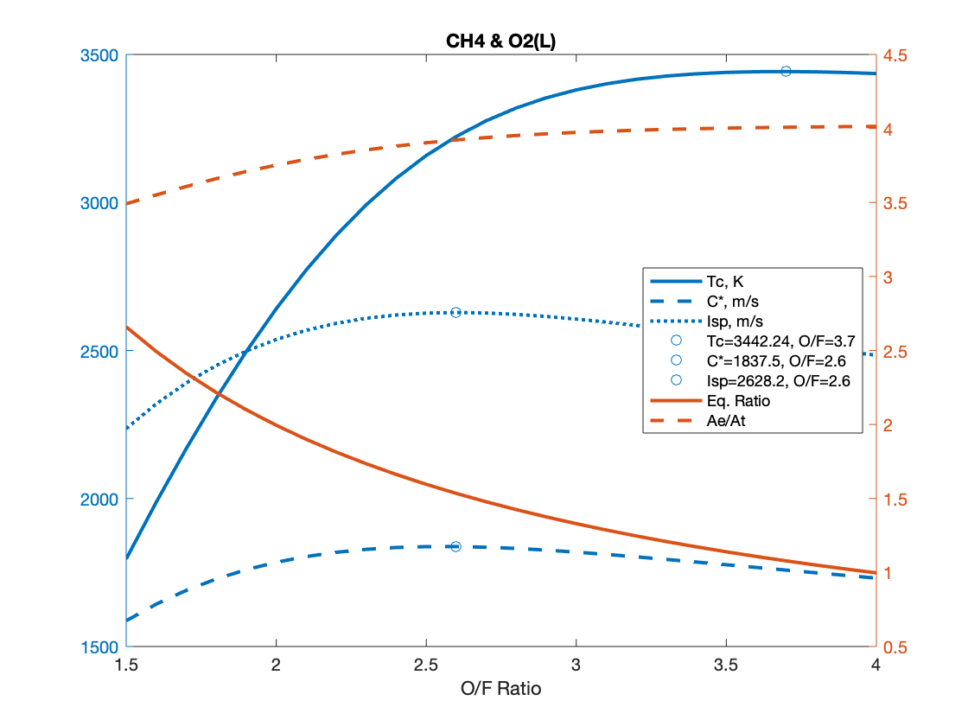
CEA Inputs:
CH4, 293.00 K
O2(L), 90.17 K
Pc = 24 bar
Pc/Pe = 23.7 (Pe = 1 atm)
Frozen Flow
At O/F = 2.6
T = 3222 K
C* = 1837.5 m/s
Isp = 2628.2 m/s (268 s)

Slide 5
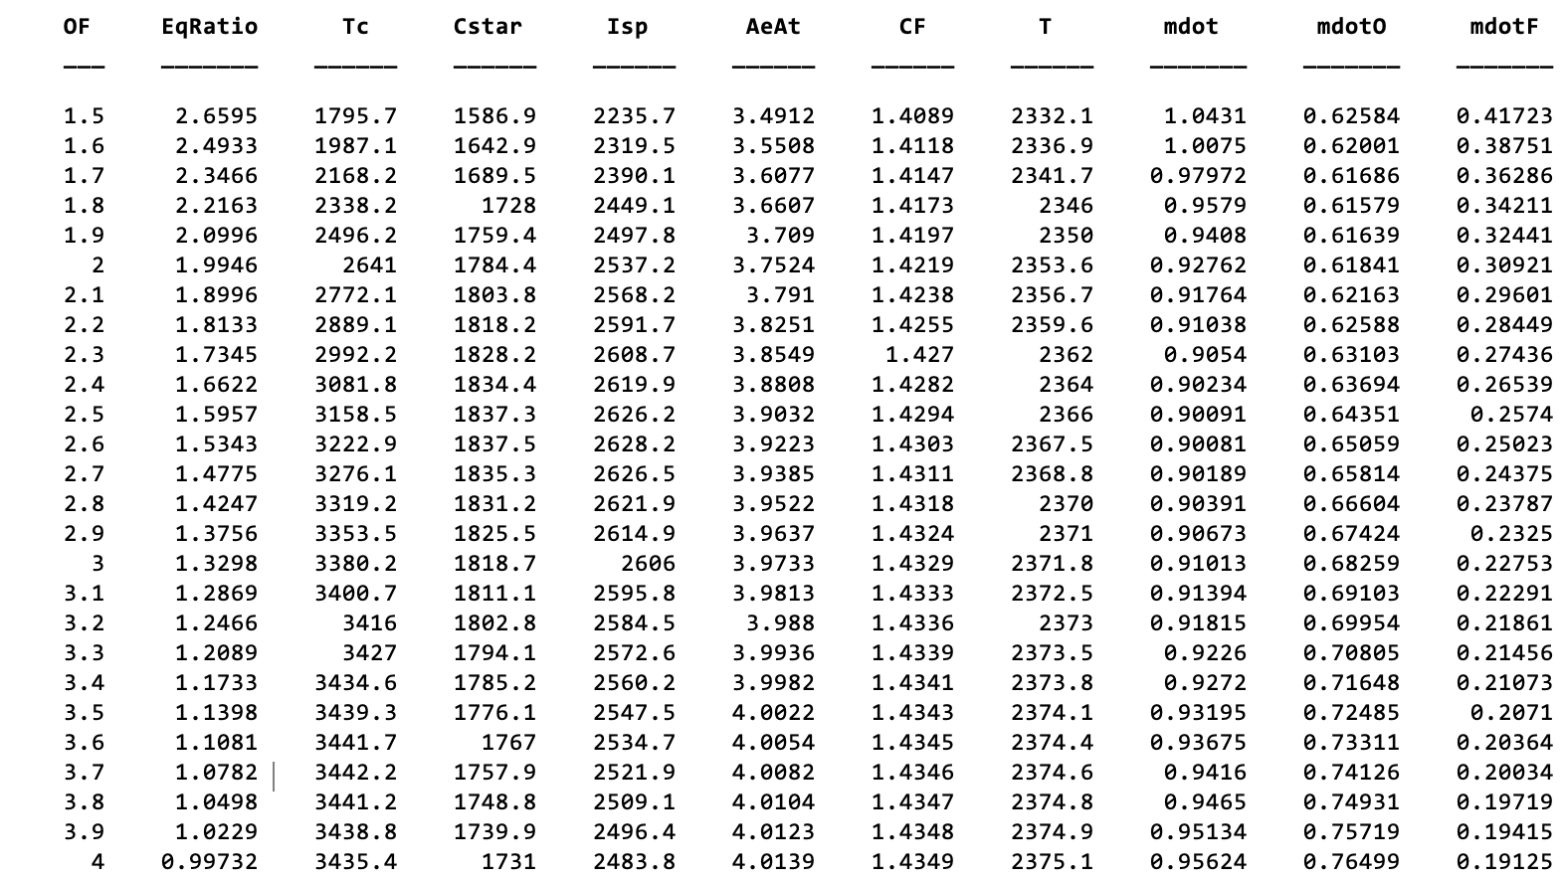

Slide 6
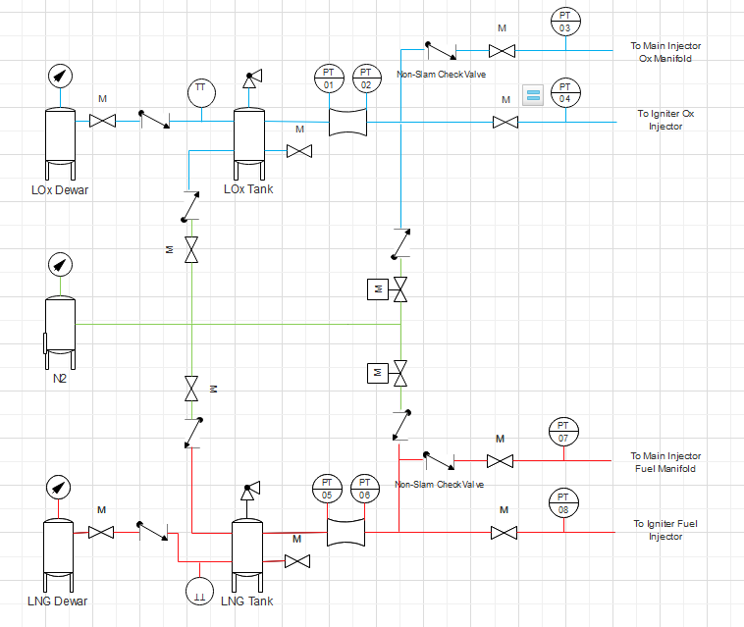
P&ID
(LCH4/LOx)

Slide 7
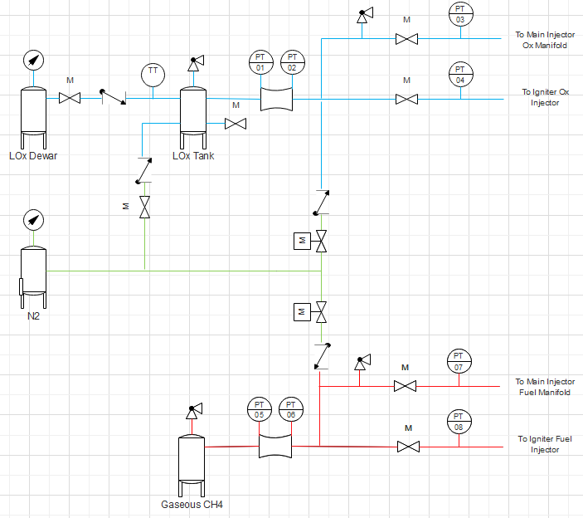
P&ID

Slide 8
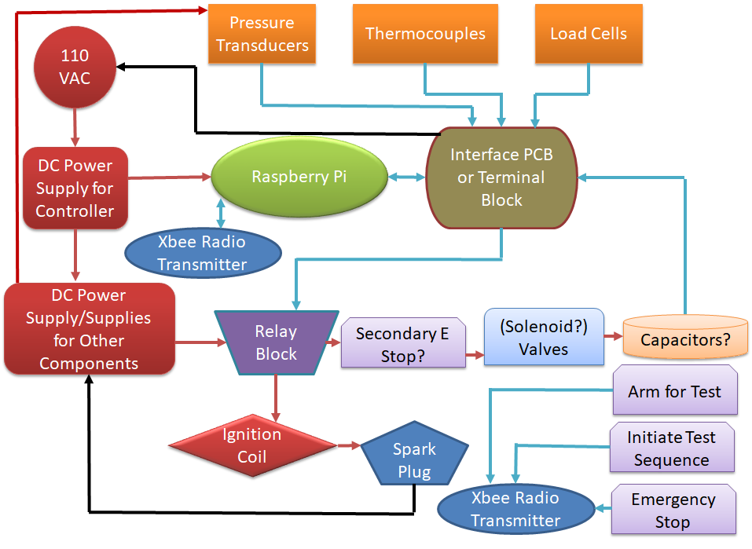
Avionics

Slide 9
Injector & Igniter
Injector
Coaxial Elements
Ox center, CH4 annular
Swirl Ox stream?
Additively Manufactured?
Igniter
Liquid Ox/ Methane, Stoichiometric mix
Swirl injection of Oxygen
Combustion chamber with a throat
External cooling jacket
Automotive spark plug (>10W)
Centered in main injector face
Injector
Igniter

Slide 10
Combustion Chamber
Chamber Wall
Thick-Wall Al6061 Tube Stock
¼” Wall
4.5” OD
FS ~11
Ablator: Canvas phenolic resin laminate tube
¼” Wall
4” OD (3.5” ID)
Chamber connects to injector plate & nozzle with flanged bolted joints
Bolts sized to ensure joint at nozzle is weak link in event of chamber overpressure (FS ~1.5)
Chamber max flow velocity ~85 m/s (from CEA chamber fluid density & chamber cross section area)
Phenolic
Chamber Wall
Notes:
Alternative: 2” ID chamber, 1.15” ID throat - Chamber max flow velocity ~250 m/s
L* 100cm -> L ~111 mm

Slide 11
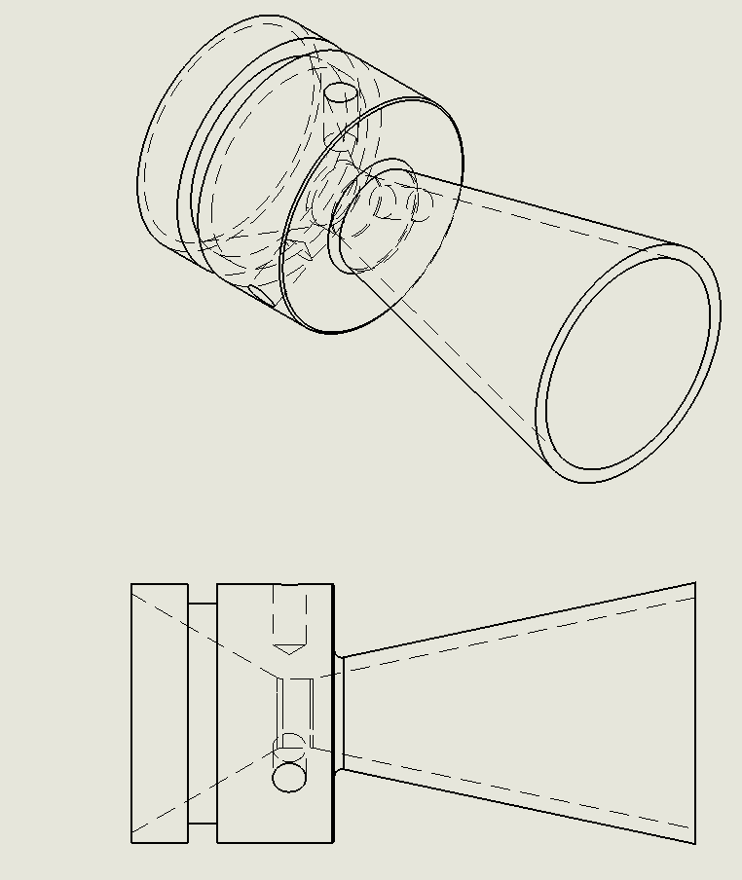
Nozzle
High-Density Graphite
Throat ID: 29.6 mm (1.166”, Chamber AR 9)
Exit ID: 58.7 mm (2.31” Ae/At 3.92 - or 74.8 mm/2.94” Ae/At 6.37)

Slide 12
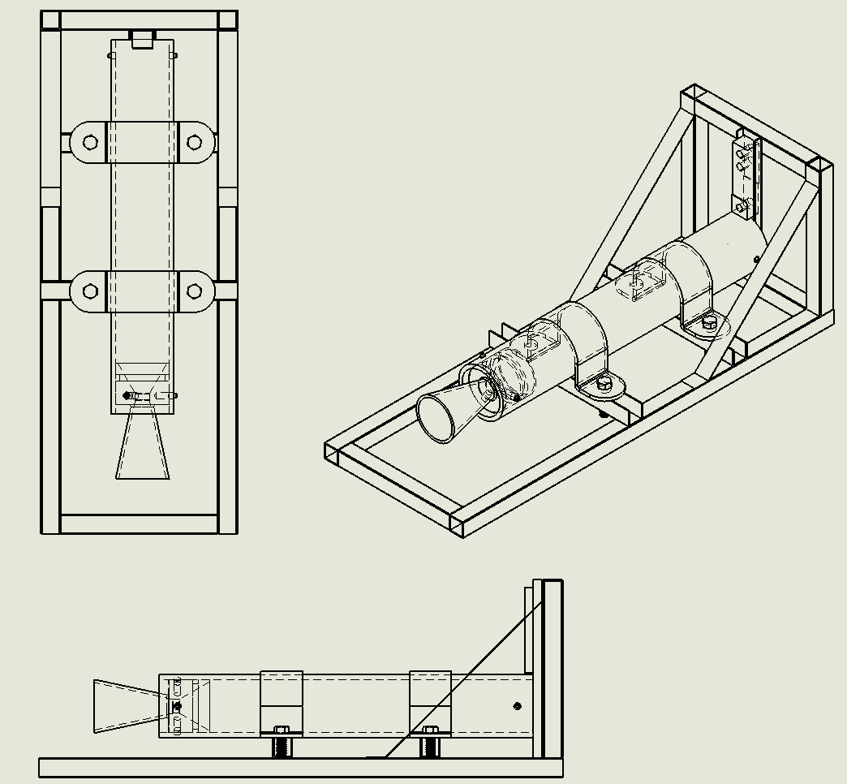
Test Stand
Design for 10 kN
Rosette on horizontal to measure bending stress
Easily accessible for tubing
Budget: 500 dollars
Used for cold flow and full engine test
Blast shielding for prop tanks
Valve mounting

Slide 13
Test Plan
Subsystem tests
Injector cold flow
Igniter reliability (multiple ignition attempts, do we get 100% success?)
Prop feed system pressurization & purge/safing
Avionics startup, data acquisition, shutdown
Full system test
Single (5 second) burn
2 burns back-to-back
Three burns back-to-back

Slide 14
Preliminary Budget
Item Group | Cost ($)
Plumbing System | 4000
Chamber & Nozzle | 1500
Propellants | 250
Injector & Igniter | 3500
Pneumatics & Electrical | 500
Test Stand | 250

